Slide 1
NATIONAL TRENDS SURVEY HINTS Dataset
IDS 506
AKASH BUNDE
HARSH JAIN
LAYA DUDI
MANIKA KONDAPARTHY

Slide 2
FEATURES
In the past 12 months, have you used a computer, smartphone, or other electronic means to do any of the following? | Electronic_SelfHealthInfo + Electronic_HealthInfoSE + Electronic_LookedAssistance Electronic_BuyMedicine + Electronic_TalkDoctor Electronic_TrackedHealthCosts + Electronic _ TestResults
Please indicate if you have each of the following. | HaveDevice_CellPh HaveDevice_None HaveDevice_Cat
On your tablet or smartphone, do you have any "apps" related to health and wellness? | TabletHealthWellnessApps
Has your tablet or smartphone | Tablet_AchieveGoal Tablet_MakeDecisio Tablet_DiscusiionsHCP
Sometimes people use the Internet to connect with other people online through social networks like Facebook or Twitter. This is often called “social media”. In the past 12 months, have you used the Internet for any of the following reasons? | IntRsn_VisitedSocNet + IntRsn_WroteBlog + IntRsn_SupportGroup IntRsn_Youtube

Slide 3
About how long has it been since you last visited a doctor for a routine checkup? A routine checkup is a general physical exam, not an exam for a specific injury, illness, or condition. | Most Recent Checkup2
In the past 12 months, not counting times you went to an emergency room, how many times did you go to a doctor, nurse, or other health professional to get care for yourself? | FreqGoProvider
The following questions are about your communication with all doctors, nurses, or other health professionals you saw during the past 12 months. How often did they do each of the following? | InvolvedDecisions + UnderstoodNextSteps
In the last 12 months, when getting care for a medical problem, was there a time when you | Probcare_BringTest + ProbCare_RedoTest + ProbCare_ProvideHist
How confident are you that safeguards (including the use of technology) are in place to protect your medical records from being seen by people who aren’t permitted to see them? | ConfidentInfoSafe

Slide 4
Have you ever looked for information about health or medical topics from any source? The most recent time you looked for information about health or medical topics, where did you go first? | SeekHealthInfo + WhereSeekHealthInfo_IMP
Based on the results of your most recent search for information about cancer, how much do you agree or disagree with each of the following statements? | CancerLotofEffort CancerFrustated CancerConcernedQuality CancerTooHardUnderstand
Imagine that you had a strong need to get information about cancer. Where would you go first? | StrongNeedCancerInfo
Do you ever go on-line to access the Internet or World Wide Web, or to send and receive e-mail? | UseInternet
How often do you access the Internet through each of the following? | WhereUseInternet_Home WhereUseInternet_Work WhereUseInternet_PublicPlace WhereUseInternet_MobileDevice

Slide 5
Have you ever been offered online access to your medical records by your health care provider or health insurer? Who offered you online access to your medical records? | EverOfferedAcessRec WhoOffered_Cat
Do any of your online medical records include the following types of medical information? | RecordsOnline_HealthProbs + RecordsOnline_Allergies RecordsOnline_VisitSummary + RecordsOnline_ClinNotes RecordsOnline_Immunizations
Has a doctor or other health professional ever told you that you had any of the following medical conditions: | MedConditions_Diabetes MedConditions_HighBP MedConditions_LungDisease MedConditions_Arthritis MedConditions_Depression
What is your current occupational status? | OccupationStatus
Do any of your online medical records include the following types of medical information? | RecordsOnline_HealthProbs + RecordsOnline_Allergies RecordsOnline_VisitSummary + RecordsOnline_ClinNotes RecordsOnline_Immunizations

Slide 6
Has a doctor or other health professional ever told you that you had any of the following medical conditions: | MedConditions_Diabetes MedConditions_HighBP MedConditions_LungDisease MedConditions_Arthritis MedConditions_Depression
What is your current occupational status? | OccupationStatus
How well do you speak English | SpeakEnglish
Starting with yourself, please mark the sex, and write in the age and month of birth for each adult 18 years of age or older living at this address | Self Gender + SelfMOB HHAdultGender2 + HHAdultMOB2 HHAdultGender3 + HHAdultMOB3 HHAdultGender4 + HHAdultMOB4 HHAdultGender5 + HHAdultMOB5
Thinking about members of your family living in this household, what is your combined annual income, meaning the total pre-tax income from all sources earned in the past year? | IncomeRanges

Slide 7

DATA LEAKAGE
Variables covered in the following questions will lead to data leakage issues
Why have you not accessed your medical record online?
In the past 12 months, have you used your online medical record to…
Have you electronically sent your medical information to…?
In general, how useful is your online medical record for monitoring your health?

Slide 8

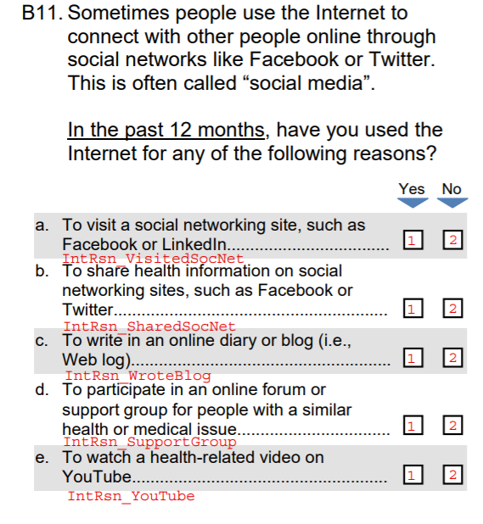

Slide 9
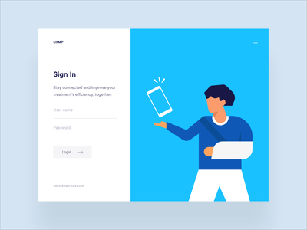
PROBLEM STATEMENT
The data collected from the survey conducted by National Institutes of Health U.S. Department of Health and Human Services is given
We need to classify whether a person signs up or not
Known facts about the data - stratified sample, approximately 7000 observations
Important variables chosen are categorical in nature

Slide 10
PROPOSED MODELS
Random Forest
Logistic Regression
KNN

Slide 11
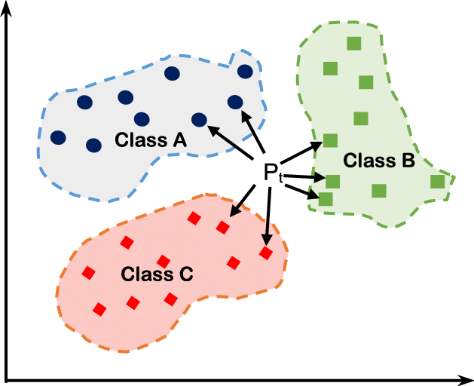
K NEAREST NEIGHBOURS
KNN is a non-parametric, lazy learning method. It predicts the classification of a new sample point using data from many classes. KNN is non-parametric since it makes no assumptions about the data it is analyzing, i.e., the model is distributed from the data.
Advantages:
It is easy to interpret
Non-parametric - no assumption about data
Disadvantages:
Accuracy depends on the quality of the data
With large data, the prediction stage might be slow. Given that it stores all of the training, it can be computationally expensive

Slide 12

LOGISTIC REGRESSION
The basis of logistic regression is the logistic function, also called the sigmoid function, which takes in any real valued number and maps it to a value between 0 and 1.
Advantages:
Logistic regression is easier to implement, interpret, and very efficient to train.
It can interpret model coefficients as indicators of feature importance.
Overfitting can be managed using regularisation terms
Disadvantages:
1.The major limitation of Logistic Regression is the assumption of linearity between the dependent variable and the independent variables.
2. Logistic Regression requires average or no multicollinearity between independent variables.

Slide 13
RANDOM FOREST
Random Forest is a technique that uses Ensemble Learning and is based on the bagging algorithm. It creates as many trees on the subset of the data and combines the output of all the trees. In this way it reduces overfitting problem in decision trees and also reduces the variance and therefore improves the accuracy.
Advantages:
Random Forest can automatically handle missing values. Random Forest is usually robust to outliers and can handle them automatically.
It is a non parametric model so there is no assumption on linearity in the data.
Disadvantages:
Difficult to interpret
For a large dataset, the training period will be long as it generates a lot of trees and makes decision on the majority of votes.

